Slide 1

A présentation on
Maintenance
Name :Prashant Raulji
Er.NO:170410107096
TY CE -2 batch –B

Slide 2
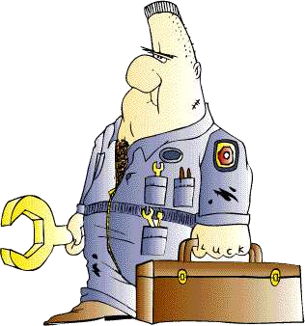
Definitions
The act of keeping, or the expenditure required to keep, an asset in condition to perform efficiently the service for which it is used.
The modification of a product, after delivery,
to correct faults,
to improve performance or other attributes,
or to adapt the product to a changed environment.

Slide 3
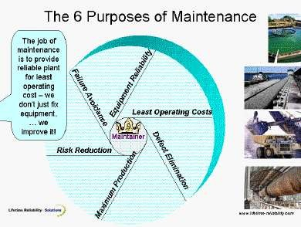





Slide 4
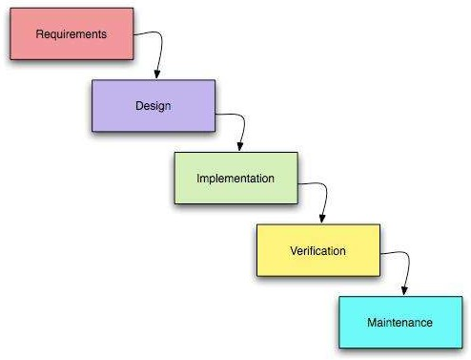
Types of Maintenance
All maintenance activities have been grouped under four classes. They are-
1.Corrective maintenance: 2.Adaptive maintenance 3.Preventive maintenance
4.Perfective maintenance

Slide 5
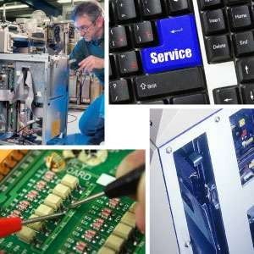
Corrective maintenance: Reactive modification of a software product performed after delivery to correct discovered problems.
system: response to equipment malfunctions
characteristics:
- inefficient maintenance department
- unpredictable equipment operation
- all maintenance work unplanned
example: light bulb replacement
results: steady degradation of equipment performance
maintenance department responsibility:
- respond to emergencies
- get production back on line

Slide 6
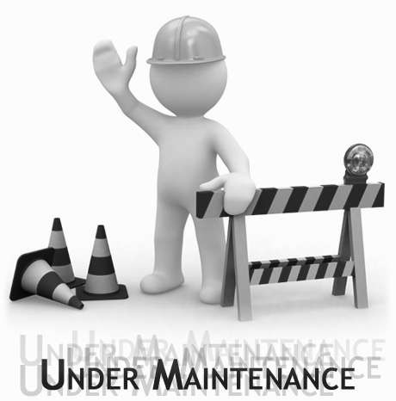
Adaptive maintenance: Modification of a software product performed after delivery to keep a software product usable in a changed or changing environment.
System: equipment design is based on minimal maintenance requirements.
Characteristics- close relationship with
equipment suppliers.
example: roadways ,websites etc results: continually improving equipment maintenance department responsibility:
- input to equipment design
- minimize & eliminate maintenance requirements

Slide 7
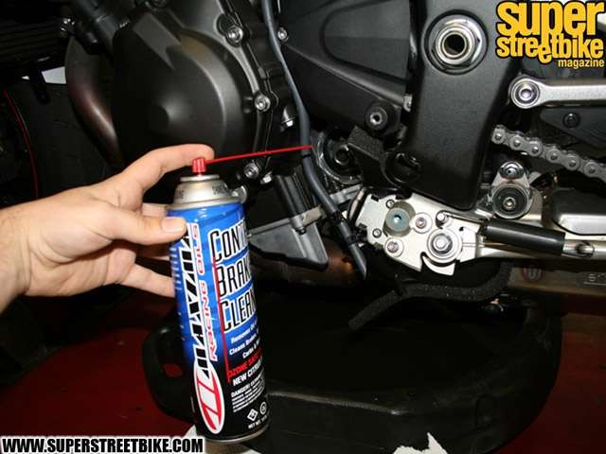
Preventive maintenance: Modification of a software product after delivery to detect and correct latent faults in the software product before they become effective faults.
system:
periodic adjustments & checks
periodic replacement of worn parts
periodic overhaul
characteristics:
more predictable
more efficient
example: changing oil & filters
results: maintain level of equipment
maintenance department
responsibility:
checking, replacing & overhauling
perform checks during maintenance

Slide 8
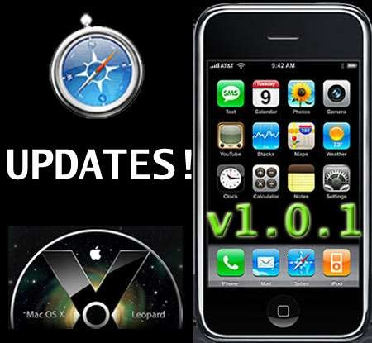
Perfective maintenance: Modification of a software product after delivery to improve performance
or maintainability.
system: periodic measurement & trending of equipment process
characteristics:
predictable maintenance requirements
-planned & scheduled equipment repairs
example: software updates and service packs. results: maintain equipment performance with minimal disruption to production maintenance department responsibility:
log equipment repairs
trend data
predict equipment repair cycles

Slide 9
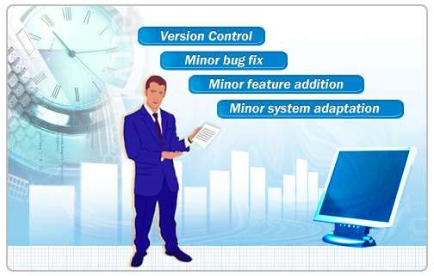
Software maintenance
Software maintenance is the process of changing a system after it has been delivered.
Modifying a program after it has been put into use.
Maintenance does not normally involve major changes to the system’s architecture.
Changes are implemented by modifying existing components and adding new components to the system.

Slide 10
Need for software maintenance
Maintenance to repair software faults
Changing a system to correct deficiencies in the way meets its requirements.
Maintenance to adapt software to a different operating environment
Changing a system so that it operates in a different environment (computer, OS, etc.) from its initial implementation.
Maintenance to add to or modify the system’s functionality
Modifying the system to satisfy new requirements.

Slide 11
Optimal maintenance
Its the discipline which is concerned with maintaining a system in a manner that maximizes profit or minimizes cost.
Cost functions depending on the reliability and maintainability characteristics of the system determine the parameters of interest to minimize.
Parameters often considered are
the cost of failure,
the cost per time unit of "downtime",
the cost (per time unit) of corrective maintenance,
the cost per time unit of preventive maintenance an
the cost of repairable system replacement

Slide 12
Maintenance costs
Maintenance costs are usually greater than development costs by a factor of 2 to 100.
The costs arise from both technical and nontechnical factors.
A deployed system is expensive to change .
High cost of breaking an already working system.
Maintenance costs increase over time and as the system evolves.
Reasons:
Maintenance changes ,degrades the original system structure.
Aging software results in high support costs.

Slide 13
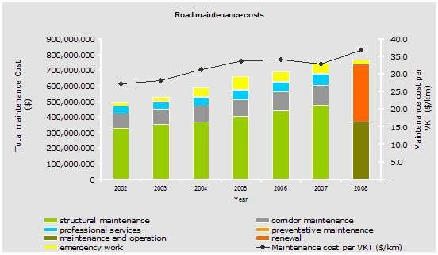
Maintenance cost factors
Team stability
Maintenance costs are reduced if the same staff are involved with
them for some time.
Contractual responsibility
The developers of a system may have no contractual responsibility
for maintenance so there is no incentive to design for future change.
Staff skills
Maintenance staff are often inexperienced and have limited domain knowledge.
Program age and structure
As programs age, their structure is degraded and they become harder to understand and change.

Slide 14
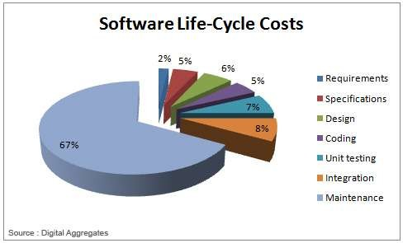
Strategies to reduce maintenance costs:
-Correct slight defects in parts and jigs.
Ensure basic equipment conditions are maintained
Review basic operations
Conduct physical analysis
Adopt an analytical approach

Slide 15
Distribution of maintenance effort
Fault rep ai r (17%)
Fun ct ion al ity additio n or mo di ficat ion (65 %)
So ftw are adapt at io n (18%)
Source:www.wikipedia.com

Slide 16
Conclusion
Maintenance is a major cost for software and must be planned for during the entire life cycle.
Design workflow —use information-hiding techniques
Implementation workflow — good coding style
Documentation must be complete, correct, and current.
During maintenance, maintainability must not be compromised.
Maintenance is so critical and challenging that the best people should be put on the task and rewarded accordingly.

Slide 17







